Slide 1

ESQC 2024
Mathematical Methods
Lecture 2
By Simen Kvaal

Slide 2
Important applications of matrices

Slide 3
The identity matrix is special
The identity matrix defines the «do nothing»-transformation:

Slide 4
Linear systems of equations
Given b, determine x such that:
Linear systems are everywhere in science
Example: Balancing reactions

Slide 5
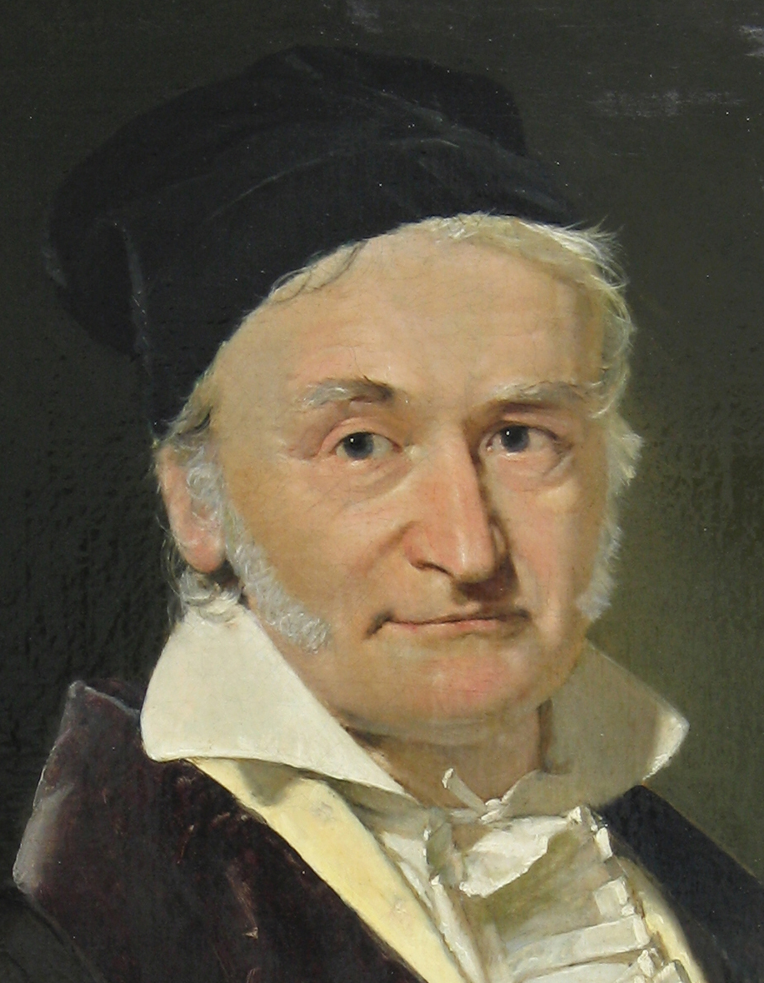
Gaussian elimination
Yes, almost everything is named after me, or should be
A method for solving linear systems
Read about it in the lecture notes!
Or watch some high-quality videos, e.g.
https://www.youtube.com/watch?v=2GKESu5atVQ (MyWhyU)
Of course, there is
  x = np.linalg.solve(A, b)

Slide 6
Inverse matrix
If A is such that solution is unique ⇒ existence of inverse matrix
Example: Inverse of plane rotation matrix
Non-existence: Singular matrix A.
Inverse given by opposite rotation

Slide 7

A mathematical roadmap
How are mathematical topics connected?
Which topics are useful for quantum chemists?
Feedback welcome!

Slide 8
A look at the roadmap
We look at the web browser
https://simenkva.github.io/esqc_material

Slide 9
At the core: Logic and set theory
All of mathematics can be built using sets

Slide 10
Naïve set theory
In our lectures, like in most mathematics, we will use naïve set theory
Informal, intuitive formalism developed late 1800s
Contrast: axiomatic set theory
  A matheatical theory with specific axioms
  Everything derived from that
Standard foundation for all of mathematics:
  ZFC = Zermelo-Fraenkel set theory with axiom of choice
Notes:
C = \{ \text{Romeo}, \text{Pallina}, \text{Micio}, \text{Luna} \} \subset \{ \text{italian cats} \} \subset \{ \text{all cats} \}

Slide 11
Basics of (naïve) set theory
A set is an unordered collection of objects:
The objects are elements:
Unrestricted comprehension generates new sets by assigning conditions on a set:
Notes:
C = \{ \text{Romeo}, \text{Pallina}, \text{Micio}, \text{Luna} \} \subset \{ \text{italian cats} \} \subset \{ \text{all cats} \}

Slide 12
Operations on sets
Union of two sets:
Intersection:
Set difference:

Slide 13
Subsets
A set can be contained in another set, i.e., be a subset:

Slide 14
Sets need not be simple ...
Infinite sets:
Sets containing sets:
Sets that are not explicitly known:

Slide 15
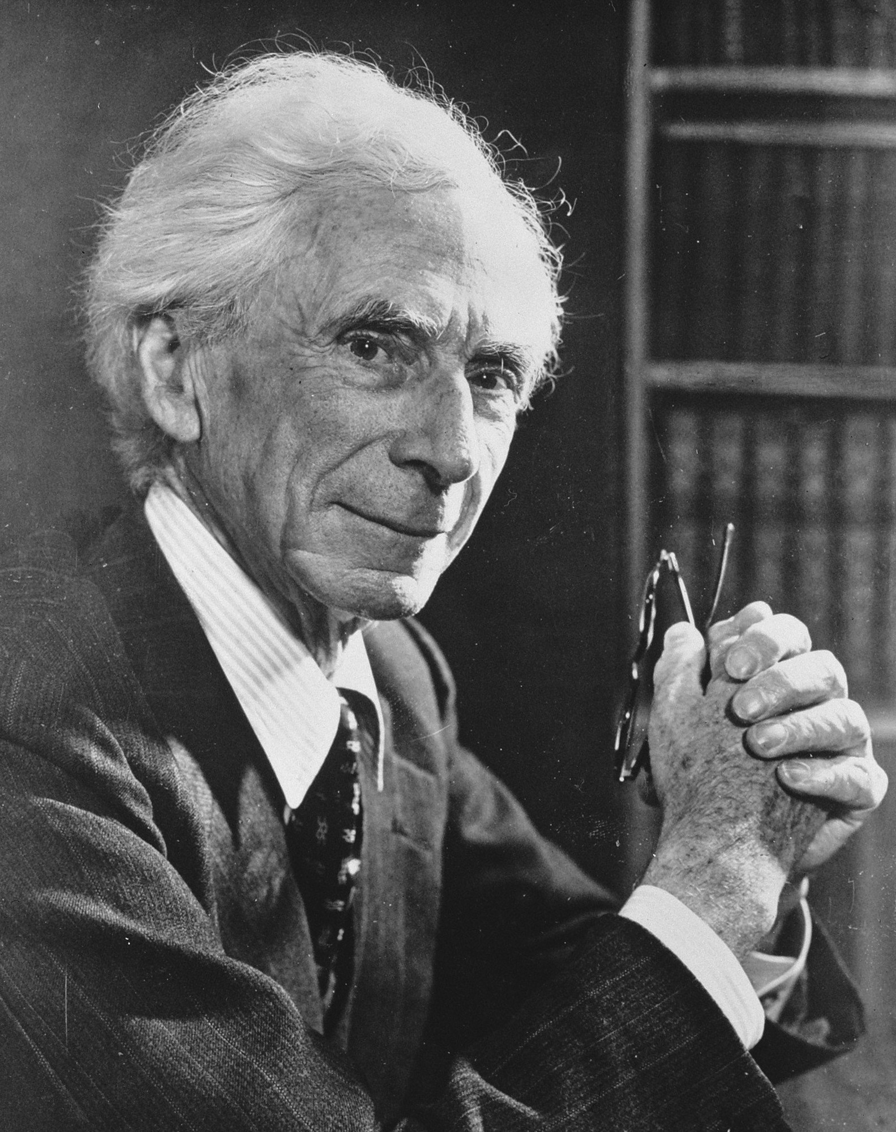
Russell’s paradox (1902)
In a town, there is a hairdresser who cuts the hair of everyone who does not cut their own hair.
Does the hairdresser cut their own hair?
Naive set theory has pitfalls
Bertrand Russell in 1957 (from Wikipedia)

Slide 16
Matrices
We pick up from last time

Slide 17
Space of matrices
A matrix is a table
Vectors are also matrices!
# cols
# rows
Notes:
A \in \mathbb{F}^{m \times n} = M(m,n;\mathbb{F})

Slide 18
Matrices = linear transformations
Notes:
A(\mathbf{x})_i = \sum_{j=1}^n A_{ij} x_j
A = \begin{bmatrix} A_{11} & A_{12} & \cdots & A_{1n} \\
A_{21} & A_{22} & \cdots & A_{2n} \\
\vdots & \vdots & \ddots & \vdots \\
A_{m1} & A_{m2} & \cdots & A_{mn} \end{bmatrix}
A(\mathbf{x}) = \begin{bmatrix} A_{11} & A_{12} & \cdots & A_{1n} \\
A_{21} & A_{22} & \cdots & A_{2n} \\
\vdots & \vdots & \ddots & \vdots \\
A_{m1} & A_{m2} & \cdots & A_{mn} \end{bmatrix} \begin{bmatrix} x_1 \\ x_2 \\ \vdots \\ x_n\end{bmatrix}

Slide 19
Matrix—matrix product
C(x) = A(B(x)) is a linear transformation, too.

Slide 20


Computing the matrix product
Also, since x is a matrix, we write
Notes:
\begin{bmatrix} A_{11} & A_{12} & \cdots & A_{1n} \\
A_{21} & A_{22} & \cdots & A_{2n} \\
\vdots & \vdots & \ddots & \vdots \\
A_{m1} & A_{m2} & \cdots & A_{mn} \end{bmatrix} \begin{bmatrix} B_{11} & B_{12} & \cdots & B_{1o} \\
B_{21} & B_{22} & \cdots & B_{2o} \\
\vdots & \vdots & \ddots & \vdots \\
B_{n1} & B_{n2} & \cdots & B_{no} \end{bmatrix} = \begin{bmatrix} C_{11} & C_{12} & \cdots & C_{1o} \\
C_{21} & C_{22} & \cdots & C_{2o} \\
\vdots & \vdots & \ddots & \vdots \\
C_{m1} & C_{m2} & \cdots & C_{mo} \end{bmatrix}

Slide 21



Important matrix operations
Transpose:
Hermitian adjoint:
Inner product as matrix product:
Notes:
(A^T)_{ij} = A_{ji} \qquad \begin{bmatrix} 0 & 1 \\ \rmi & 2 \\ 0 & -1 \end{bmatrix}^T = \begin{bmatrix} 0 & \rmi & 0 \\ 1 & 2 & -1 \end{bmatrix}

Slide 22
More on matrices
Matrices are very central to quantum chemistry and numerical methods in general

Slide 23
Examples of matrices working in 2D Euclidean space
Show Jupyter notebook
  Lecture 2 – plane transformations.ipynb
Examples of: rotation, reflection, scaling
Composition of linear transformations

Slide 24
The structure of a matrix
A matrix has a set of columns
What happens if we compute Ax ?
A linear combination of the columns

Slide 26
Example
What is the column space of the identity matrix?
The columns are the standard basis vectors – a basis for 𝔽³
… so the column space should be 𝔽³ as well!
Arbitrary in 𝔽³

Slide 27
Systems of linear equations
A main problem in linear algebra
Let A ∈ 𝔽^{n⨉n}
System of linear equations:
When does this system have a unique solution?
Answer: When the matrix has rank n / col. space is a basis

Slide 28
Gaussian elimination
Yes, almost everything is named after me, or should be
A method for solving linear systems
Read about it in the lecture notes!
Or watch some high-quality videos, e.g.
https://www.youtube.com/watch?v=2GKESu5atVQ (MyWhyU)

Slide 29
Inverse matrix
Existence of unique solution gives inverse matrix
Example: Inverse of plane rotation matrix
Non-existence: Singular matrix A.
Inverse given by opposite rotation!

Slide 30
Example cont.

Slide 31
Special classes of matrices

Slide 32
Notation for n-dim Hilbert spaces

Slide 34
What’s so special about Hermitian A?
Only Hermitian operators have real diagonal matrix elements
In quantum mechanics, observables are modelled with operators.
Expectation value:
Thus observables must be Hermitian!

Slide 35
U preserves angles!

Slide 36
What characterizes a unitary matrix?
U is unitary if and only if the columns are orthonormal

Slide 37


What does a unitary matrix do?
U changes basis from standard basis to arbitrary orthonormal basis

Slide 38
Example
Rotation matrix

Slide 39
Matrix decompositions
Useful tools for characterizing and solving problems

Slide 40
Eigenvalue equation
Here posed as an “abstract” equation in Hilbert space
Central equation of quantum chemistry:
When a basis is introduced:
Can we find solutions? How many solutions?
Matrix eigenvalue problem (EVP)

Slide 41
There exists an orthonormal basis such that A is just stretching of axes

Slide 42
POWERFUL!

Slide 43
Illustration from Wikipedia (user Georg-Johann), modified by me

Slide 44
Example
For example, useful for image compression
Frobenius norm on matrices:
Truncated SVD gives optimal approximation in this norm!
Show Jupyter notebook with SVD of bitmap image

Slide 45
General finite-dimensional vector spaces
With several examples

Slide 46
😬

Slide 47



Space of polynomials
A basis, but no longer Euclidean space
dimension
Polynomials of degree ≤ n
A simple function space
Show: Jupyter notebook
Differentiation operator (n = 4)
derivative as a matrix!
Notes:
P_n = \left\{ f : [0,1] \to \mathbb{C} \mid f(x) = a_0 + a_1 x + a_2 x^2 + \cdots + a_n x^n, \; \mathbf{a} \in \mathbb{C}^{n+1} \right\}
D_{ji} = i \delta_{j,i-1}, \quad D = \begin{bmatrix} 0 & 1 & 0 & 0 & 0 \\ 0 & 0 & 2 & 0 & 0 \\ 0 & 0 & 0 & 3 & 0 \\ 0 & 0 & 0 & 0 & 4 \\ 0 & 0 & 0 & 0 & 0 \end{bmatrix}

Slide 48
Space of matrices
The space M(n) of square matrices (over some field) is a vector space
It is equal to 𝔽^{m} , m = n² dimensions
But we have an additional structure:
Vector space with vector-vector multiplication = algebra

Slide 49
A finite-dimensional C*-algebra
In the second-quant lectures,
We can consider an operator which is a polynomial
If N spin-orbitals: max N particles, so max degree is 2N
So a finite dimensional vector space of operators
Algebra: A vector space with a multiplication operation
Notes:
c_\ell \qquad c^\dag_k \qquad \{c_\ell, c^\dag_k \} = \delta_{\ell k}
+ \sum_{k\ell} \alpha_{k\ell} c_k c_\ell + \sum_{k\ell} \beta_{k\ell} c^\dag_k c_\ell + \sum_{k\ell} \gamma_{k\ell} c^\dag_k c^\dag_\ell

Slide 50
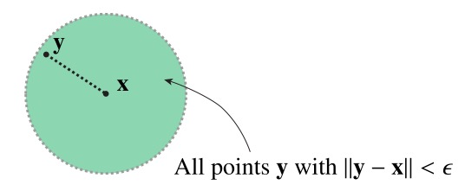
Inner product, norm
What these examples lack compared to Euclidean space:
  A sense of distance
  Euclidean space, as model of reality, comes with the intuition of which points are close to each other

Slide 51
General vector spaces
Vector space
(linear structure)
Euclidean space
Comes with linear structure + inner product
Mathematical abstraction
Topology,
e.g., inner product, norm, or metric
Other structures, e.g.,
multiplication

Slide 52
In Euclidean space: the standard basis
Polynomials: the various x^{i}

Slide 53



Basis for finite-dimensional spaces

Slide 54
Example
The standard basis in Euclidean space:
The monomials in polynomial space:
A basis is never unique
Notes:
\mathbf{x} = \sum_{i=1}^n x_i \mathbf{e}_i
p(x) = \sum_{i=0}^n a_i x^i

Slide 55
Examples: bases in the plane
Standard basis, non-orthogonal basis, and not-a-basis

Slide 56
A line through the origin
A plane through the origin
Polynomials without constant terms
Square integrable wavefunctions with finite kinetic energy

Slide 57
All vector spaces of dimension n are isomorphic – the same
(… when it comes to the linear structure)
And linear transformations become …. matrices!
Action of operator in the given basis
Notes:
v = \sum_{i=1}^n x_i b_i\quad \longrightarrow \quad \mathbf{x} \in \mathbb{F}^n
\alpha v = \sum_{i=1}^n \alpha x_i b_i\quad \longrightarrow \quad \alpha \mathbf{x} \in \mathbb{F}^n
v_1 + v_2 = \sum_{i=1}^n ( x_{i1} + x_{i2} ) b_i\quad \longrightarrow \mathbf{x}_1 + \mathbf{x}_2 \in \mathbb{F}^n

Slide 58
Finite-dimensional Hilbert spaces
Finite dim vector space + inner product = Hilbert space

Slide 59
All Hilbert spaces of dimension n are the same
“overlap matrix”
… when an orthonormal basis is selected
Let V be a finite dim Hilbert space with given basis
Inner prod induces an inner product on
It is not the Euclidean inner product unless
Orthonormal basis
Notes:
\braket{v,v'} = \sum_{i=1}^n\sum_{j=1}^n \bar{x}_i \braket{b_i, b_j} x_j \equiv \mathbf{x}^H S \mathbf{x},

Slide 60
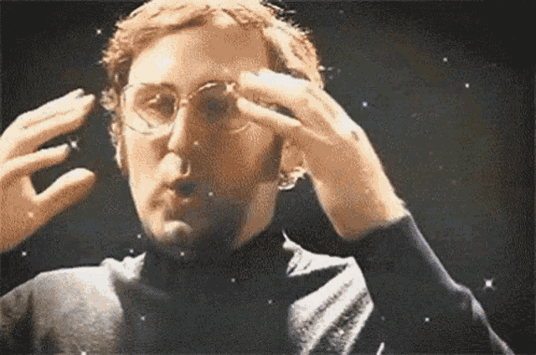

Slide 61
End of lecture 2
That’s it for today!

